Slide 1
Logical Statements and Selection Structures

Slide 2
Car Loan Problem
You have saved some amount to use as a down payment on a car. Before beginning your car shopping, you decide to write a program to help you figure out what your monthly payment will be, given the car’s purchase price, the monthly interest rate, and the time period over which you will pay back the loan. The formula for calculating your payment is
payment = iP / (1 - (1 + i)^{-n} )
where P = principal (the amount you borrow)
i = monthly interest rate (1/12 of the annual rate)
n = total number of payments
Total number of payments is usually 36, 48, or 60 (months). Program should then display the amount borrowed and the monthly payment rounded to two decimal places.

Slide 3
Car Loan problem
Input | Output | Logic Involved
Purchase price, down payment, annual interest rate and total number of payments | Amount borrowed and EMI | Compute Monthly payment = i*P / (1 - (1 + i)^{-n} )

Slide 4
Algorithm for Car Loan Problem
Read input such as Purchase price, down payment, annual interest rate and total number of payments from user
amount_Borrowed = purchase_Price – down_Payment
EMI = i*P / (1 - (1 + i)^{-n} )
Print amount_Borrowed and EMI rounded to two decimal places

Slide 5
Implementation in C
Already learnt to read input and print values
Learnt about arithmetic operators
The expression has to find power of a value
Similarly some problems may need to find square root or log values, trigonometric values etc...
Have to learn to format output as it is specified in problem to print two digits after decimal point

Slide 6
Library Functions
Predefined Functions and Code Reuse
A primary goal of software engineering is to write error-free code.
Code reuse - reusing program fragments that have already been written and tested whenever possible, is one way to accomplish this goal.

Slide 7
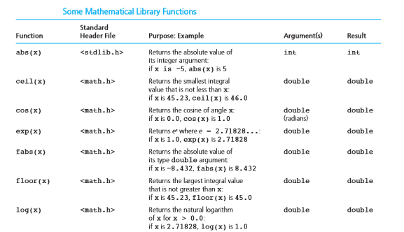

Slide 8
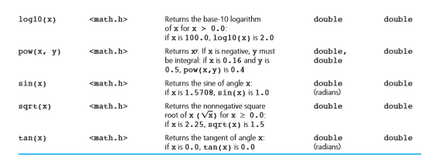

Slide 9
Scanf and printf
scanf and printf are also predefined functions that are defined in the header file stdio.h
scanf - returns the number of items successfully read
printf() - returns the number of characters successfully written on the output

Slide 10
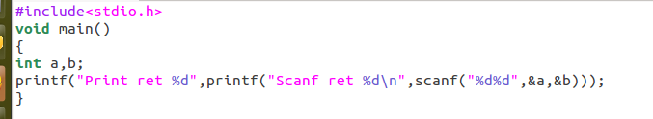
Example
On giving inputs as:
34 45
Output of Program is: Scanf ret 2 Print ret 12

Slide 11
Formatting Output
Additional arguments in pritnf to format as requested by user:
%[flags][width][.precision][length]specifier

Slide 12
Formatting Output
Flags | Description
- | Left-justify within the given field width; Right justification is the default
+ | Forces to precede the result with a plus or minus sign (+ or -) even for positive numbers. By default, only negative numbers are preceded with a -ve sign.
(space) | If no sign is going to be written, a blank space is inserted before the value
0 | Left-pads the number with zeroes (0) instead of spaces, where padding is specified

Slide 13
Formatting Output
Width | Description
(number) | Minimum number of characters to be printed. If the value to be printed is shorter than this number, the result is padded with blank spaces.
.precision | Description
.number | precision specifies the minimum number of digits to be written. If the value to be written is shorter than this number, the result is padded with leading zeros.

Slide 14
Formatting Output
length | Description
h | Argument is interpreted as a short int or unsigned short int (only applies to integer specifiers: i, d, o, u, x and X).
l | argument is interpreted as a long int or unsigned long int for integer specifiers (i, d, o, u, x and X), and as a wide character or wide character string for specifiers c and s.
L | argument is interpreted as a long double (only applies to floating point specifiers: e, E, f, g and G)

Slide 15
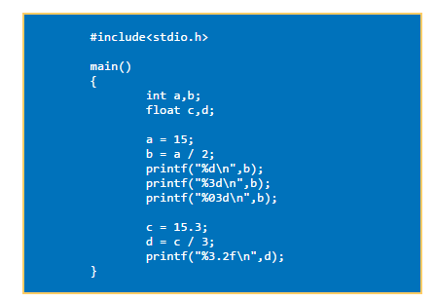
Example for Formatting

Slide 16
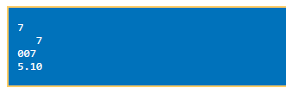
Output

Slide 17
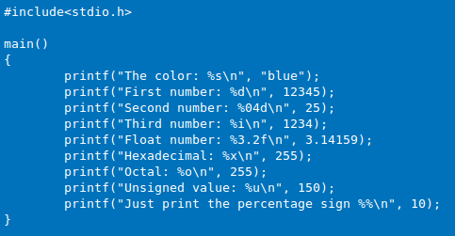
Example for Formatting

Slide 18
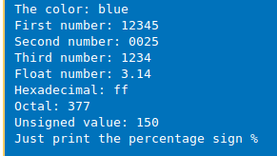
Output

Slide 19
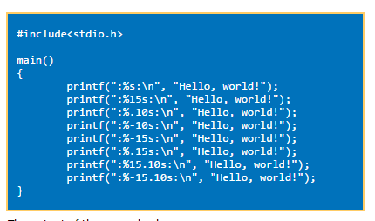
Example for Formatting

Slide 20
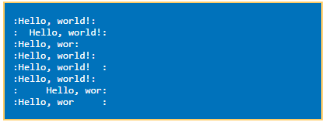
Output

Slide 21
printf(“:%s:\n”, “Hello, world!”); - nothing special happens
printf(“:%15s:\n”, “Hello, world!”); print 15 characters. If string is smaller then “empty” positions will be filled with “whitespace.”
printf(“:%.10s:\n”, “Hello, world!”); statement prints the string, but print only 10 characters of the string.
printf(“:%-10s:\n”, “Hello, world!”); statement prints the string, but prints at least 10 characters. If the string is smaller “whitespace” is added at the end.

Slide 22
printf(“:%-15s:\n”, “Hello, world!”); statement prints the string, but prints at least 15 characters. The string in this case is shorter than the defined 15 character, thus “whitespace” is added at the end (defined by the minus sign.)
printf(“:%.15s:\n”, “Hello, world!”); statement prints the string, but print only 15 characters of the string. In this case the string is shorter than 15, thus the whole string is printed.

Slide 23
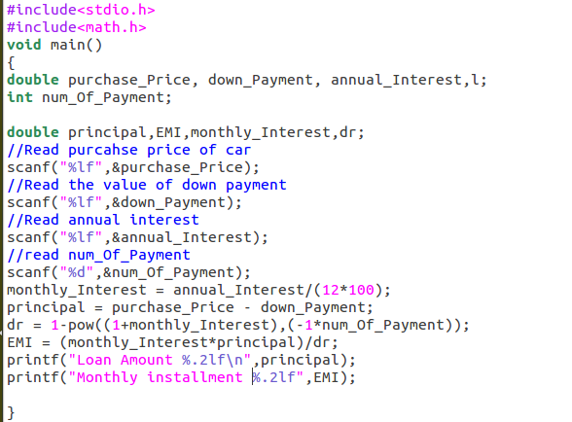

Slide 24
To compile – gcc carloan.c –lm
./a.out
When input is:
400000
100000
10
36
Output is:
Loan Amount 300000.00 Monthly installment 9680.16

Slide 25
Nature of a Solution
A solution may be classified into acidic, very acidic, neutral, alkaline or very alkaline based on its pH value. The nature of the solution is given by the following table and determined as shown in the figure:
pH value | Nature of Solution
0 to 2 | Very acidic
Greater than 2 and less than 7 | Acidic
Equal to 7 | Neutral
Greater than 7 and less than 12 | Alkaline
Greater than 12 | Very Alkaline

Slide 26
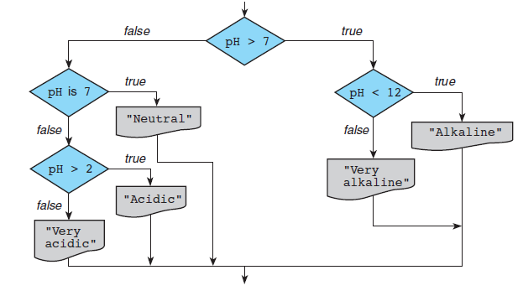
Nature of a Solution

Slide 27
pH problem
Input | Output | Alternate Ways for Solution
pH value of solution | Nature of solution | Compare value and make decision

Slide 28
Algorithm
Get the pH value of the solution from the user
Write instructions that will make decision for nature of solution as per details in the table
Print the nature of the solution

Slide 29
Partial C code
#include<stdio.h>
void main()
{
float ph_Value; // Declare necessary variables
//Get the ph_Value from the user
scanf(“%d”,&ph_Value);
// Based on ph_Value make decision and print
}

Slide 30
Type of Instructions
Instructions are organized into three kinds of control structures to control execution flow:
Sequence
Selection
Repetition
A selection control structure chooses which alternative to execute

Slide 31
Compound Statements
Until now we have been using only sequential flow
A compound statement, written as a group of statements bracketed by { and } , is used to specify sequential flow.
{
statement 1 ;
statement 2 ;
...
statement n ;
}

Slide 32
Data Types
No boolean and no String data type in C as in Python
C uses 0 and 1 values to indicate true and false

Slide 33
Defining Constants
Similar like a variable declaration except the value cannot be changed
In declaration, const keyword is used before or after type
int const a = 1; const int a =2;
It is usual to initialise a const with a value as it cannot get a value any other way.

Slide 34
Pre-processor definition
#define is another more flexible method to define constants in a program
#define TRUE 1
#define FALSE 0
#define NAME_SIZE 20
Here TRUE, FALSE and NAME_SIZE are constant

Slide 35
Relational and Equality Operators
Variable relational-operator variable
Variable relational-operator constant
Variable equality-operator variable
Variable equality-operator constant

Slide 36
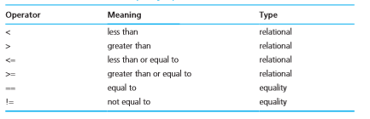
Relational and Equality Operators

Slide 37
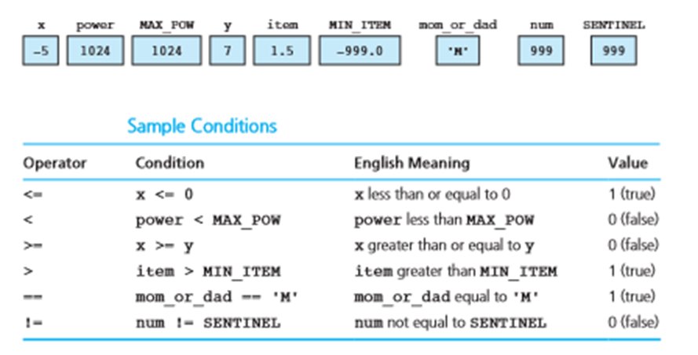
Examples
Memory with Values

Slide 38
Logical Operators
To form more complicated conditions or logical expressions
Three operators:
And (&&)
Or (||)
Not(!)

Slide 39
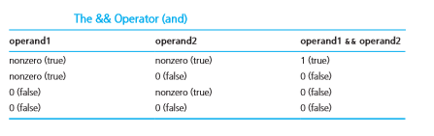
Logical And

Slide 40
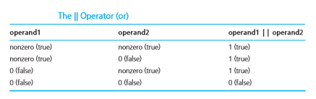
Logical Or

Slide 41
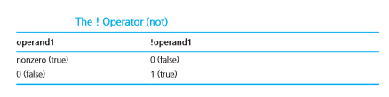
Logical Not

Slide 42
True/False Values
For numbers all values except 0 is true
For characters all values except ‘/0’ (Null Character) is true

Slide 43
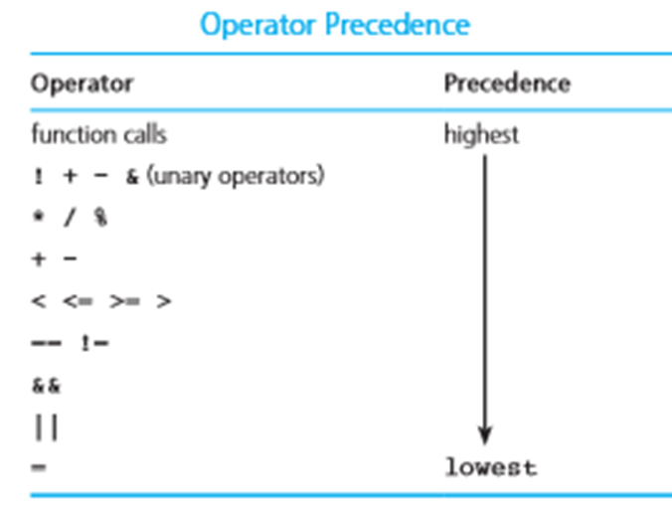

Slide 44

!flag
1 (true)

Slide 45
x + y / z <= 3.5
5.0 <= 3.5 is 0 (False)

Slide 46
!flag ||(y + z >= x-z)
1 ||1 = 1

Slide 47
Short Circuit Evaluation
Stopping evaluation of a logical expression as soon as its value can be determined is called short-circuit evaluation
Second part of ‘&&’ does not gets evaluated when first part is evaluated as False
Second part of ‘||’ does not gets evaluated when first part is evaluated as true

Slide 48
(a>100) && (a>b) && (a>c)
ftt
A=99
B=56
C=37

Slide 49
Short Circuit Evaluation
(num % div == 0) – Runtime error if div = 0
But prevented when written as
(div != 0 && (num % div == 0))

Slide 50
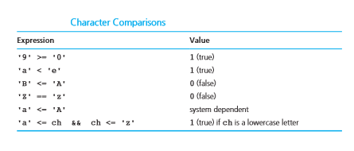
Comparing Characters
We can also compare characters in C using the relational and equality operators

Slide 51
Logical Assignment
even = (n % 2 == 0);
in_range = (n > -10 && n < 10);
is_letter = ('A' <= ch && ch <= 'Z') || ('a' <= ch && ch <= 'z');
Variable in_range gets 1 (true) if the value of n is between −10 and 10 excluding the endpoints;
is_letter gets 1 (true) if ch is an uppercase or a lowercase letter.

Slide 52
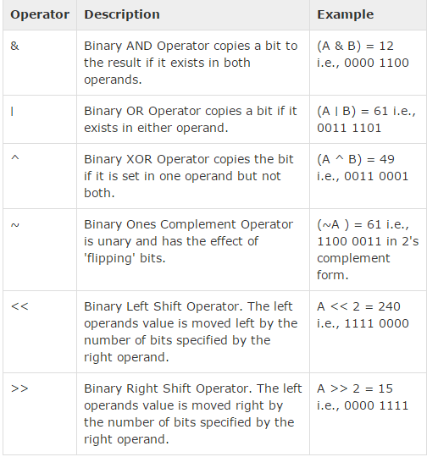
When 'A‘ = 60 and 'B' =13

Slide 53
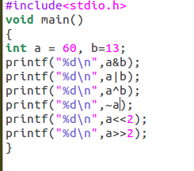

Slide 54
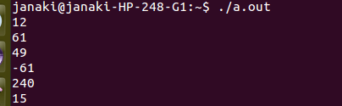

Slide 55
Syntax of if Statement Two Alternatives
Form 1:
if ( condition )
statement _{T} ;
Eg:
if (x > 0.0)
pos_prod = pos_prod * x;
If condition evaluates to true (a nonzero value), then statement _{T} is executed; otherwise, statement _{T} is skipped.

Slide 56
Syntax of if Statement Two Alternatives
Form 2:
if ( condition )
statement _{T} ;
else
statement _{F} ;

Slide 57
Example
if (x >= 0.0)
printf("positive\n");
else
printf("negative\n");
If condition evaluates to true ( a nonzero value), then statement_{T} is executed and statement_{F} is skipped; otherwise, statement_{T} is skipped and statement_{F} is executed.

Slide 58
Example 1
#include<stdio.h> void main() { float i=0.0f; if(i) printf("Yes");
else
printf(“No”); }

Slide 59
Output 1
No

Slide 60
Example 2
#include<stdio.h> void main() { int i=-3; if(i) printf("Yes");
else
printf(“No”); }

Slide 61
Output 2
Yes

Slide 62
Example 3
#include<stdio.h> void main() { char i =‘a’; if(i) printf("Yes");
else
printf(“No”); }

Slide 63
Output 3
Yes

Slide 64
Example 4
#include<stdio.h> void main() {
int a = 2 , b=5;
if ((a==0)&&(b=1))
printf(“Hi”);
printf(“a is %d and b is %d”, a, b);
}

Slide 65
Output 4
a is 2 and b = 5

Slide 66
Example 5
#include<stdio.h> void main() {
int a = 2 , b=5;
if ((a==2)&&(b=1))
printf(“Hi”);
printf(“a is %d and b is %d”, a, b);
}

Slide 67
Output 5
a is 2 and b = 1

Slide 68
Conditional Operator (Ternary Operator)
Syntax:
expression 1 ? expression 2 : expression 3
“if expression 1 is true (that is, if its value is non-zero), then the value returned will be expression 2, otherwise the value returned will be expression 3”.

Slide 69
Conditional Operator (Ternary Operator)
Example:
char a ;
int y ;
scanf ( "%c", &a ) ;
y = ( a >= 65 && a <= 90 ? 1 : 0 ) ;
Here 1 would be assigned to y if a >=65 && a <=90 evaluates to true, otherwise 0 would be assigned

Slide 70
Conditional Operator (Ternary Operator)
Not necessary that conditional operators should be used only in arithmetic statements
Eg1:
int i ;
scanf ( "%d", &i ) ;
( i == 1 ? printf ( "Amit" ) : printf ( "All and sundry" ) )
Eg2:
char a = 'z' ;
printf ( "%c" , ( a >= 'a' ? a : '!' ) ) ;

Slide 71
Nested
Conditional operators can be nested :
int big, a, b, c ;
big = ( a > b ? ( a > c ? 3: 4 ) : ( b > c ? 6: 8 ) ) ;
a > b ? g = a : g = b ;
Compiler Error
a > b ? g = a : ( g = b ) ;

Slide 72
Partial C code of Isogram Problem Extended
/* Code to get the number of letters from user and print it*/
#include<stdio.h>
int main()
{
int num_Of_Letters; // Declaration of variable is mandatory in C
int num_Of_Words ; // Memory is allocated but not initialized
scanf(“%d”,&num_Of_Letters);
//If num_Of_Letters in less than or equal to zero then error
if (num_Of_Letters<=0)
printf(“Invalid input”);

Slide 73
Partial C code of Isogram Problem Extended
else
{
printf(“Number of letters is %d”,num_Of_Letters);
// multiply all numbers from n to 1 to find number of
// number of isogram words that can be formed
}
}

Slide 74
Nested if Statements
if (x >= 0.0)
printf("positive\n");
else
printf("negative\n");
If condition evaluates to true ( a nonzero value), then statement_{T} is executed and statement_{F} is skipped; otherwise, statement_{T} is skipped and statement_{F} is executed.

Slide 75
Nested if Statements
if ( condition₁ )
statement₁
else if ( condition₂ ) else (a>b)
statement₂
. . .
else if ( condition_{n})
statement_{n}
else
statement_{e}

Slide 76
Example
/* increment num_pos, num_neg, or num_zero depending on x */
if (x > 0)
num_pos = num_pos + 1;
else if (x < 0)
num_neg = num_neg + 1;
else /* x equals 0 */
num_zero = num_zero + 1;

Slide 77
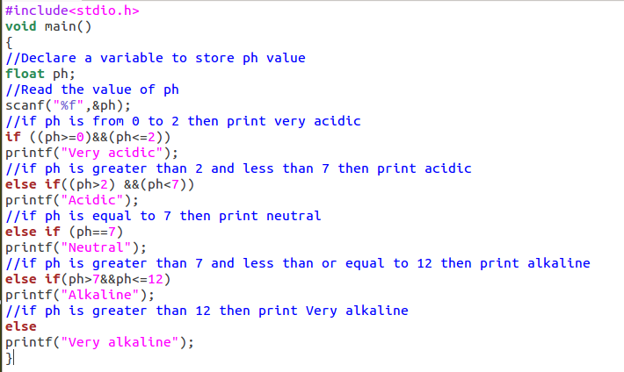

Slide 78
#define statements
These are preprocessor directives that are used define constants
When a value is defined using #define, if there is a change in value it is easier to make modification

Slide 79
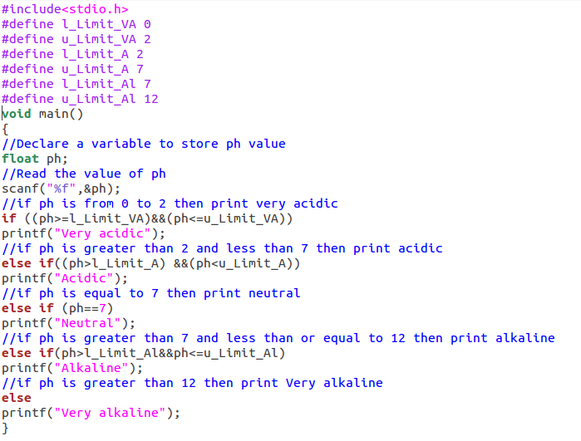

Slide 80
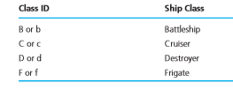
Class of the Ship
Each ship serial number begins with a letter indicating the class of the ship. Write a program that reads a ship’s first character of serial number and displays the class of the ship.

Slide 81
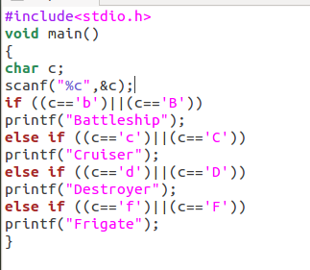
Nested if Statements

Slide 82
Switch Statement
Useful when the selection is based on the value of a single variable or of a simple expression (called the controlling expression)
Value of this expression may be of type int or char , but not of type double

Slide 83
Syntax of Switch Statement
switch ( controlling expression )
{
label set₁
statements₁
break;
label set_{n}
statements_{n}
break;
default:
statements_{d}
}

Slide 84
Syntax of Switch Statement
When a match between the value of the controlling expression and a case label value is found, the statements following the case label are executed until a break statement is encountered.
Then the rest of the switch statement is skipped.
If no case label value matches the controlling expression, the entire switch statement body is skipped unless it contains a default label.

Slide 85
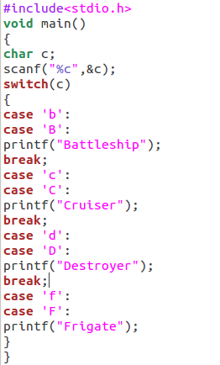

Slide 86
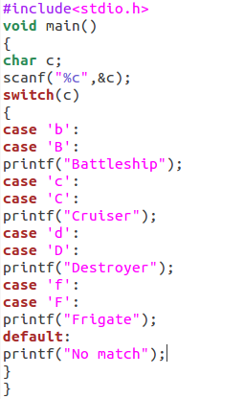
Output
BattleshipCruiserDestroyerFrigateNo match
When input is b

Slide 87
In Lab Practice Problem
The table below shows the normal boiling points of several substances. Write a program that prompts the user for the observed boiling point of a substance in °C and identifies the substance if the observed boiling point is within 5% of the expected boiling point. If the data input is more than 5% higher or lower than any of the boiling points in the table, the program should output the message Substance unknown.

Slide 88
Substance | Normal boiling point (°C)
Water | 100
Mercury | 357
Copper | 1187
Silver | 2193
Gold | 2660

